Slide 1
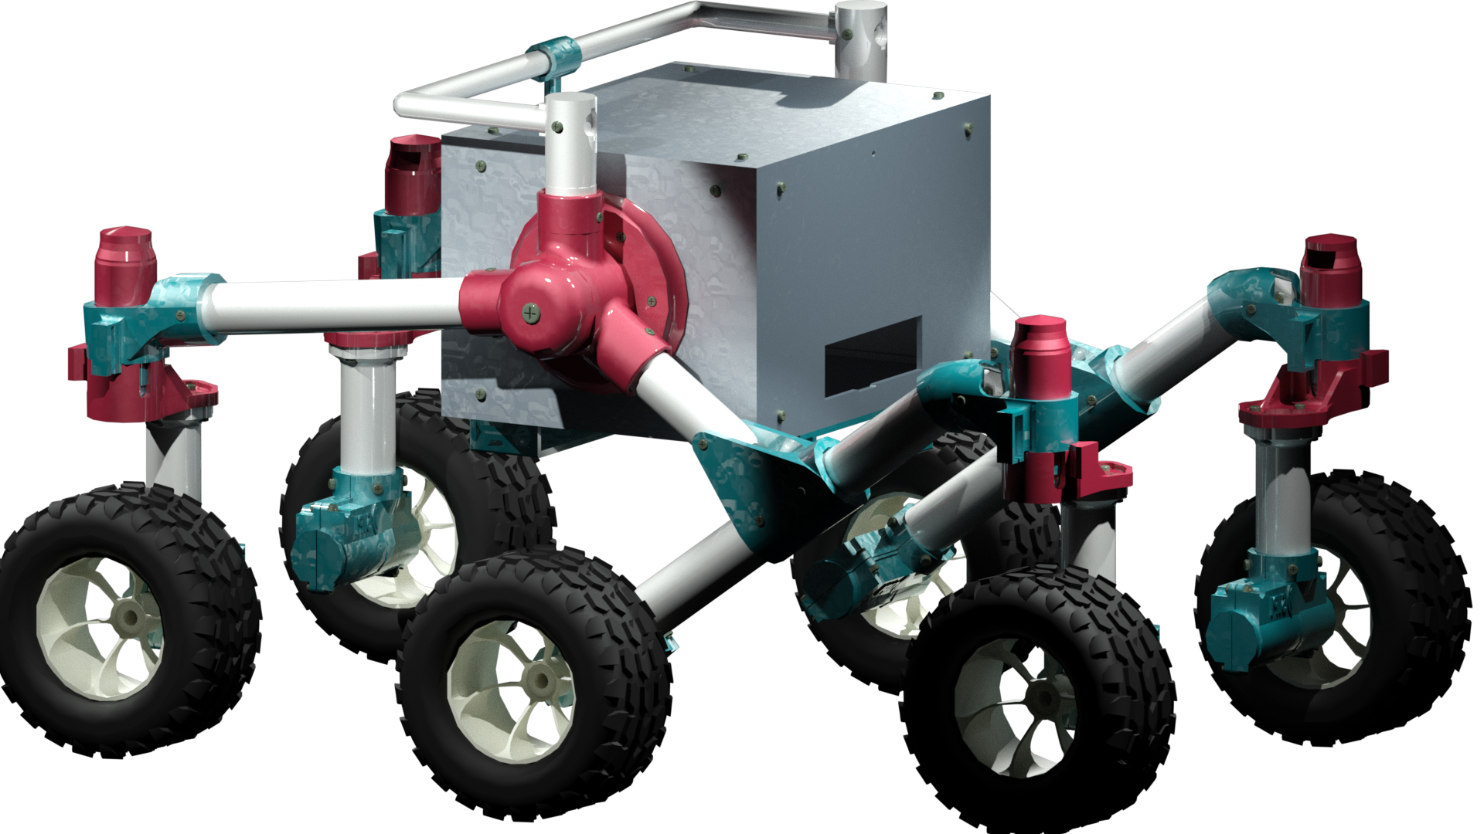
ROV-S ASSEMBLY MANUAL

Slide 2
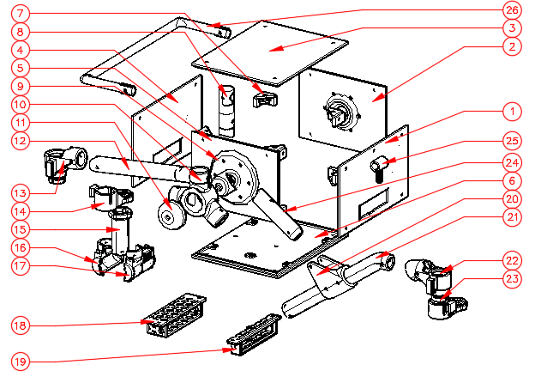

Slide 3
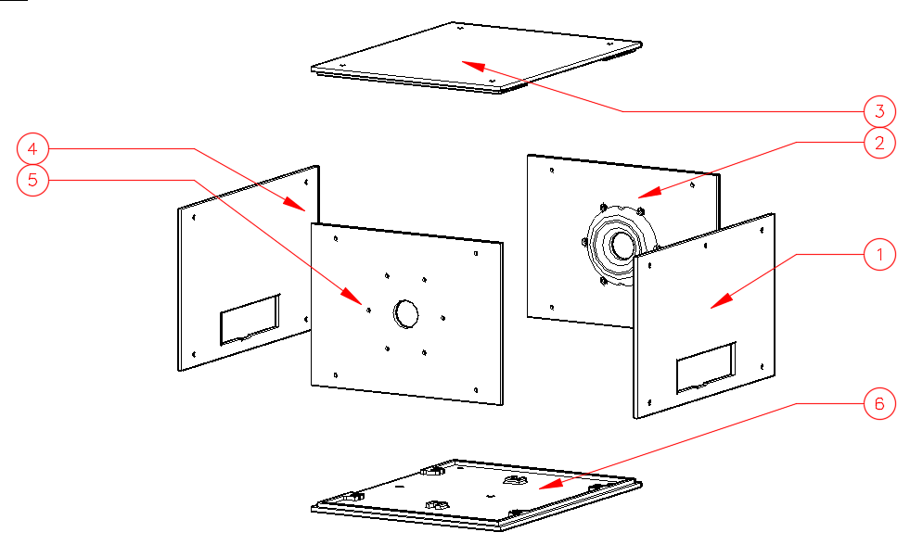
D1

Slide 4
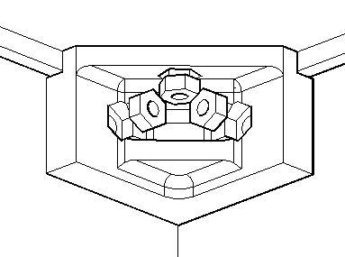
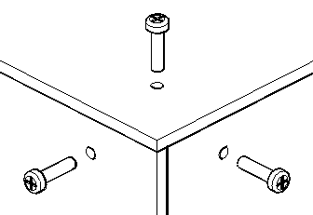
STEP 1
STEP 2
D1

Slide 5
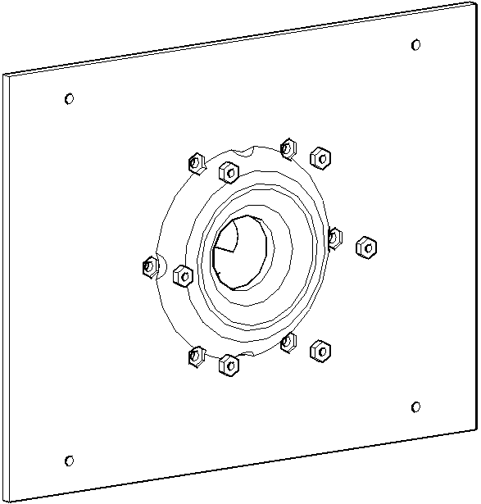
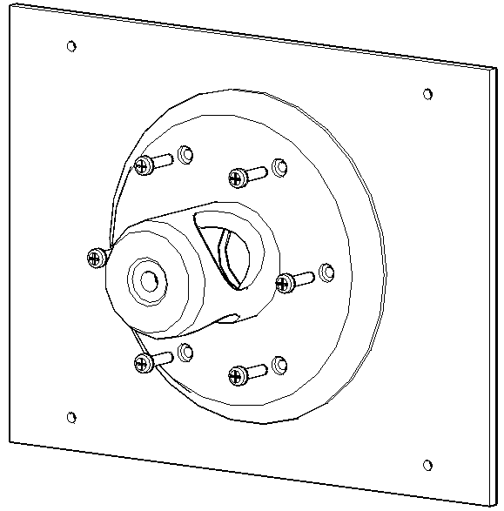
INSIDE
OUTSIDE
STEP 1
STEP 2

Slide 6
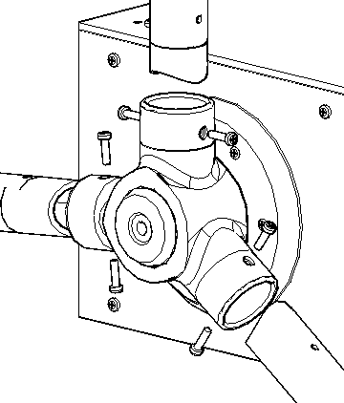
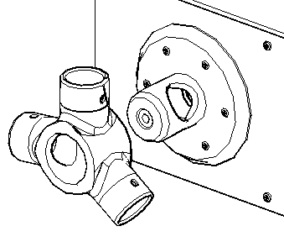
D2
B
A
A
C
C

Slide 7
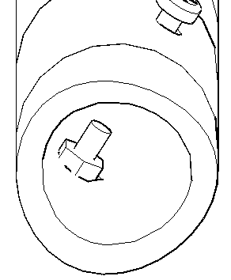
A
D2

Slide 8
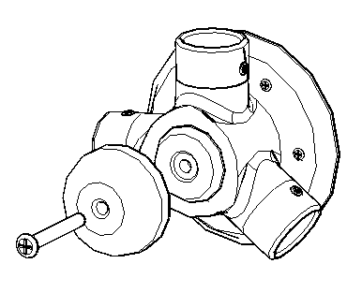

A
A
D3
B
C
D3

Slide 9
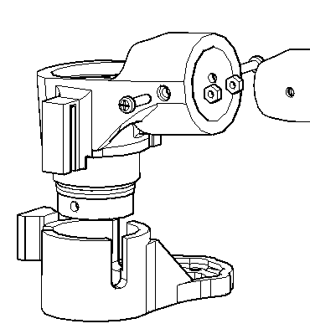
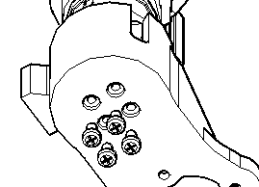
STEERING MOTOR INSERTED HERE
B
LIMIT SWITCH INSERTED HERE
A
D4
C
D5
D5

Slide 10
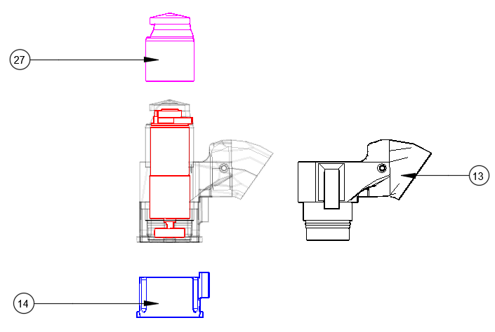
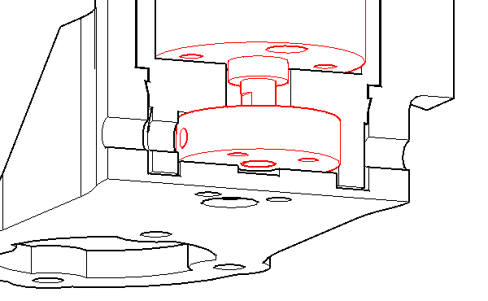
D4
D4

Slide 11
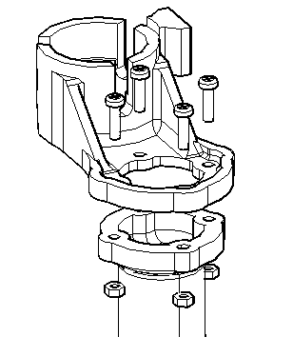
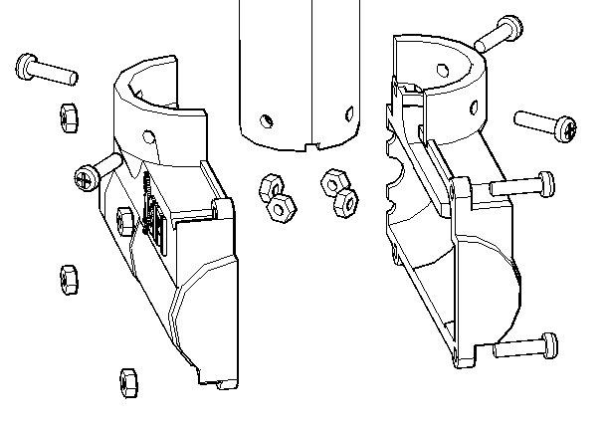
D
C
A
B
DRIVE MOTOR INSERTED HERE

Slide 12
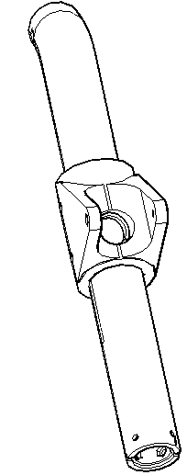
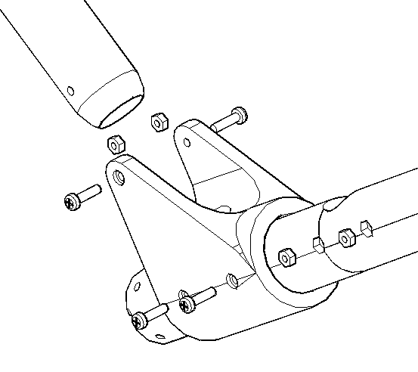
ALIGN HOLES FOR PROPER FIT
D6

Slide 13
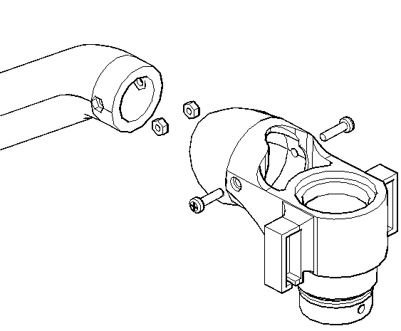
STEERING MOTOR INSERTED HERE
A
B
LIMIT SWITCH INSERTED HERE

Slide 14
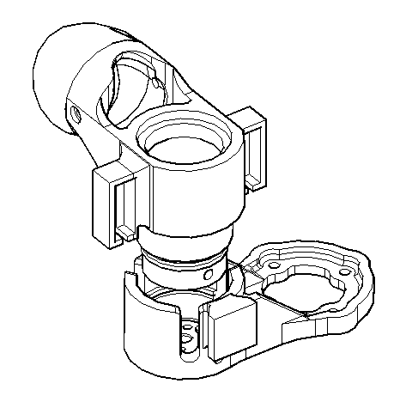

Slide 15
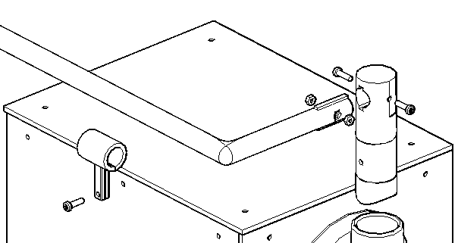
D
C
A
B

Slide 16
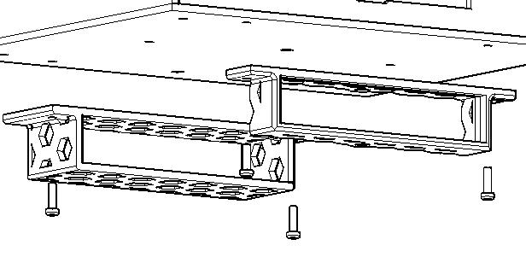
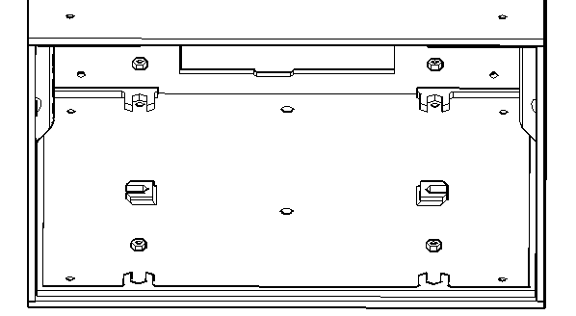
OUTSIDE
INSIDE

Slide 17
